Slide 1


Community Input-Output Modeling
The US Environmentally Extended Input-Output Model (USEEIO) is a national life cycle model that combines environmental and economic data to characterize both positive and negative effects associated with the production and consumption of goods and services in the United States. It tracks close to 400 commodities and over 2000 resources, emissions, and waste types to characterize 20+ environmental and economic indicators. USEEIO is widely used by corporations, including Amazon, nonprofits, government and academia for applications such as carbon footprinting and sector-based environmental assessment.
The EPA, GA Department of Economic Development, and Georgia Tech are working with Georgia communities interested in using the model to evaluate economic and environmental outcomes through web applications that specifically address community concerns by combing the national USEEIO model with local data to add detail to the evaluation. Our projects include working with stakeholders in a public-private partnership of 6 Southeast Georgia counties to collect material generation data to assess the impact of new technological improvements, innovative recovery, alternative use of available materials, and increased material efficiency.
Using the Georgia version of the USEEIO model, teams will investigate linkages between material data and the regionalized IO model using information gathered on: (1) industries or final uses that are generating the materials, (2) how the materials currently are used, disposed or handled, (3) possible uses of the material to substitute for current industry material or energy requirements, (4) other technological and environmental changes related to material use and substitution, and (5) the market consequences of scaling up material cycling changes.
The resulting regional material flow analysis will include characterization of local material streams in both quantity and quality using data from local stakeholders. The regional focus provides an opportunity to add detail to the national model for the unique needs of local project planning and economic development.
We’re partnering with Georgia communities to create online tools to evaluate how technological changes in local industries, utilities and logistics can reduce carbon footprints and protect the environ-ment while creating jobs and new business opportunities.

Slide 2
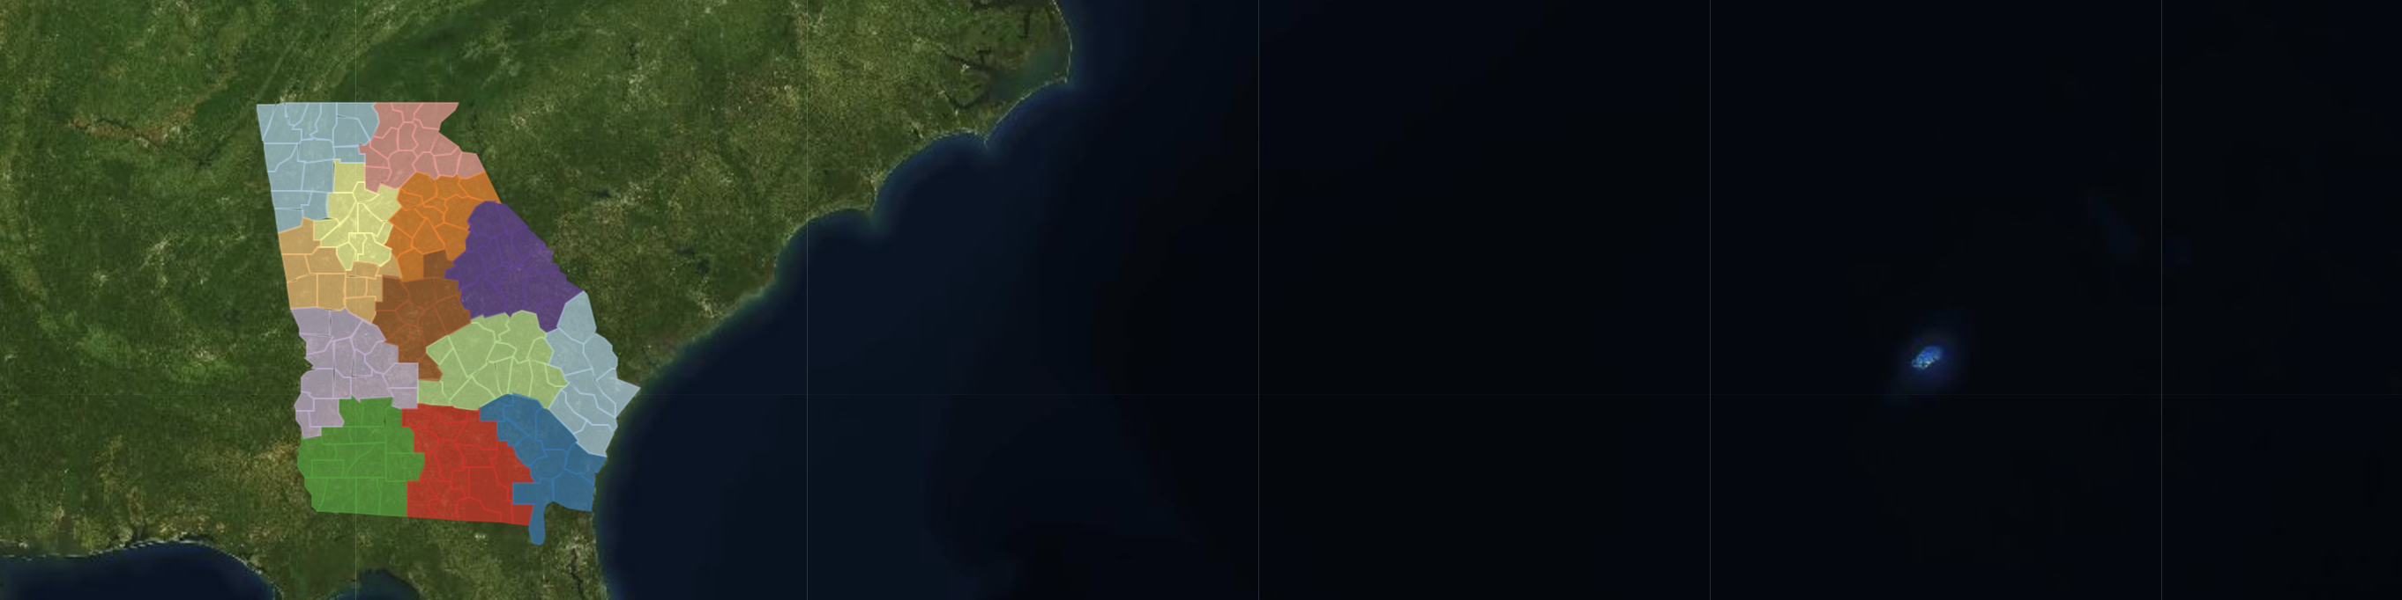
Georgia Team
Georgia’s flagship projects with the EPA
Regional Sustainability and Environmental Sciences Research Program (RESES)
Community-Driven Application Development using USEEIO Models
Wesley Ingwersen, US Environmental Protection Agency
USEPA Environmental Engineer Wes Ingwersen…
Loren Heyns, Georgia Department of Economic Development
GDEcD Programmer Analyst Loren Heyns is a Georgia Tech PhD student in Computational Science and Civil and Environmental Engineering. Loren's background includes developing websites for Georgia Power, Georgia State Parks, Green Law, Southeast Environmental Education, Georgia Film and Video, and business directories for Georgia Aerospace, Trade and Logistics.
Project Interns Community Data Collection Hands on role for individuals working in communities to collect and prepare data for analysis.
Community Material Flow Analysis Our material flow intern will process community data using Python to create interactive supply chain visualizations.
New Technology Scenario Analysis Our technology scenario intern will build R Language tools to convey industry purchases, resource use and emissions.

